Slide 1
Pirate’s Treasure!
Zack Russ

Slide 2
A Platformer
A simple platform game using pygame.
Player collects jewels and progresses through the levels.

Slide 3
The Player
The player is a small pirate sprite drawn in paint.
There are 4 frame states: 2 walking left and 2 walking right.

Slide 4
The Levels
There are five playable levels in all.
Each level has a jewel near the top.
The player exits at the top right.

Slide 5
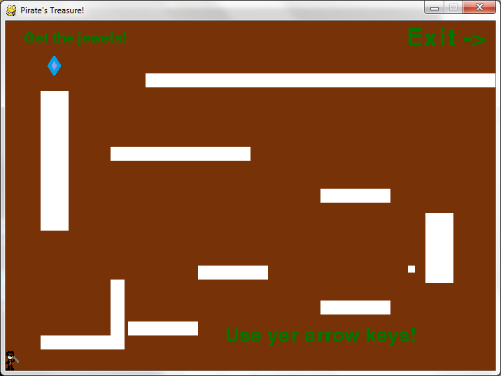
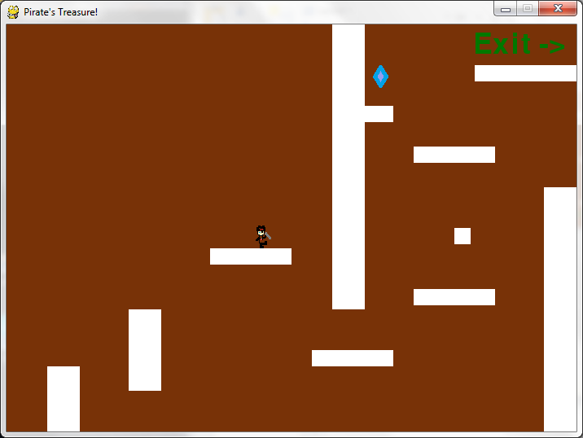
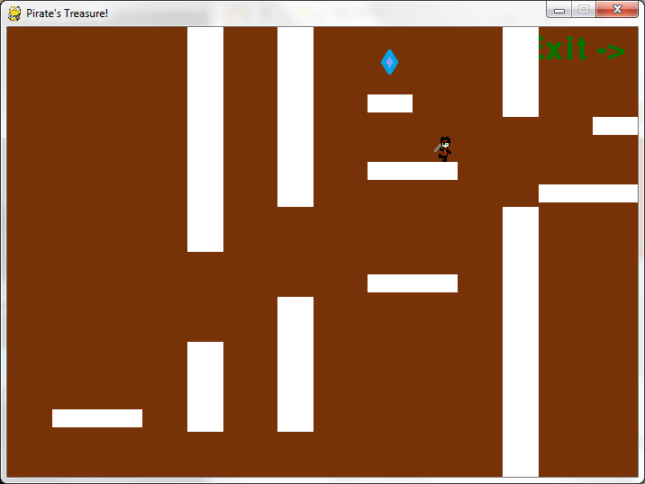
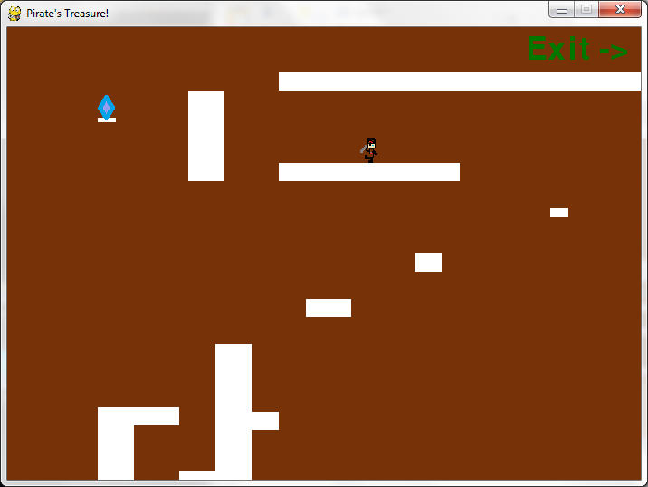

Slide 6
Gameplay
Players use arrow keys to move.
Up key makes players jump.
Players must reach the top of the level to get the jewel and go to the next level.
Time is kept while playing and stops when the player reaches the game over screen (level 7).

Slide 7
Codes
All codes used in this game are based off of the examples provided on Blackboard and the book: Making Games with Python and Pygame, by Al Sweigart.
All levels are stored in a separate module called Levels.

